Slide 1
Fulbright Science School
Ayson, Ronald Martin
Tabudlong, Jhun Michael

Slide 2
Background of the client
Fulbright Science School, located at Guadalupe, Makati City. They are committed to giving quality education and values information. They wanted the school to become an ideal learning institution and encourage students with their reasoning skills, practice and explore their environment.

Slide 3
Background of the project
Fulbright Science School Assistance Program is a website developed to showcase the equipment, facilities and programs of the school and help promote the school’s quality education. Supposedly a grading system developed for the Grade 1 – Grade 10 students exclusively.

Slide 4
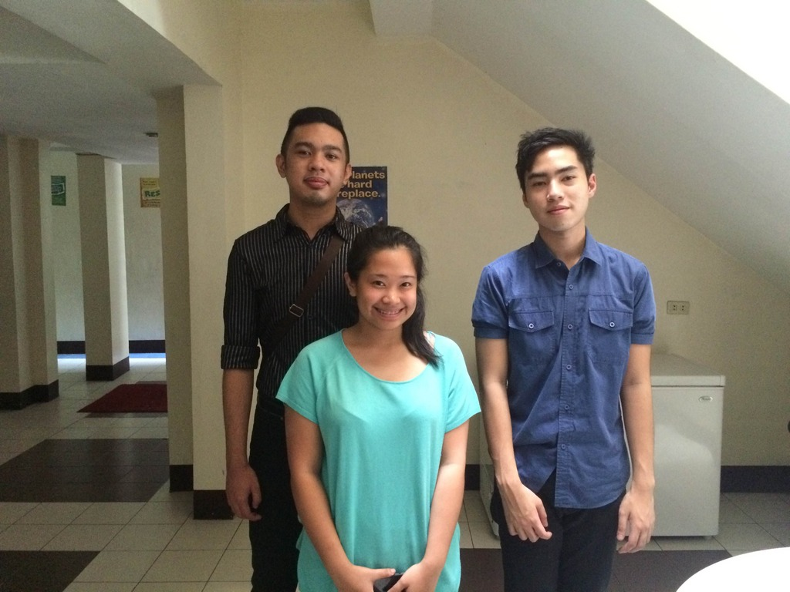
Review of the Iterations and Client Meeting

Slide 5
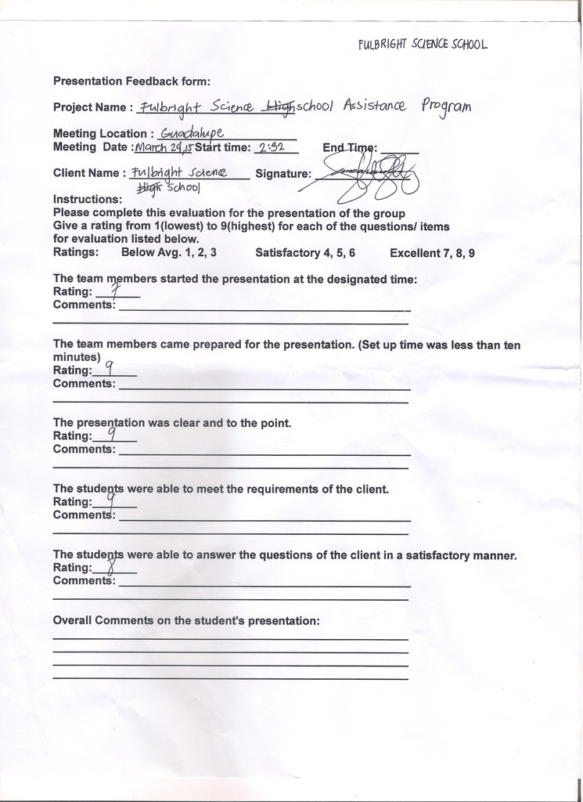
Client Feedback Form

Slide 6
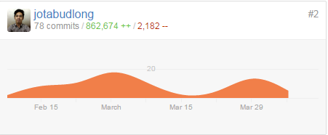
Commits, and Contributions(Tabudlong, Jhun Michael)

Slide 7
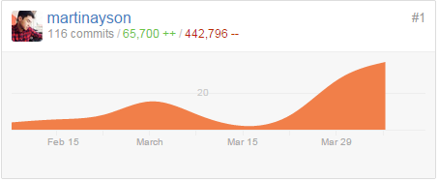
Commits, and Contributions(Ayson, Ronald Martin I.)

Slide 8
Status of the Project
Percent Completed: 60%

Slide 9
Status of the Project
Remaining work to be completed:
-Viewing of grading system for parents and students

Slide 10
Status of the Project
Client Feedback:
The client doesn’t want us to continue with the system, because of the past experiences they’ve encountered with a paperless system specifically a database management system that keeps the student records, grades and information which is corrupted and all the files were lost.

